Slide 1
Look, Ma, No Neurons! Knowledge Base Completion Using Explicit Inference Rules
William W Cohen
Machine Learning Department
Carnegie Mellon University
joint with
William Wang, Katie Mazaitis, Rose Catherine Kanjirathinkal, ….

Slide 2
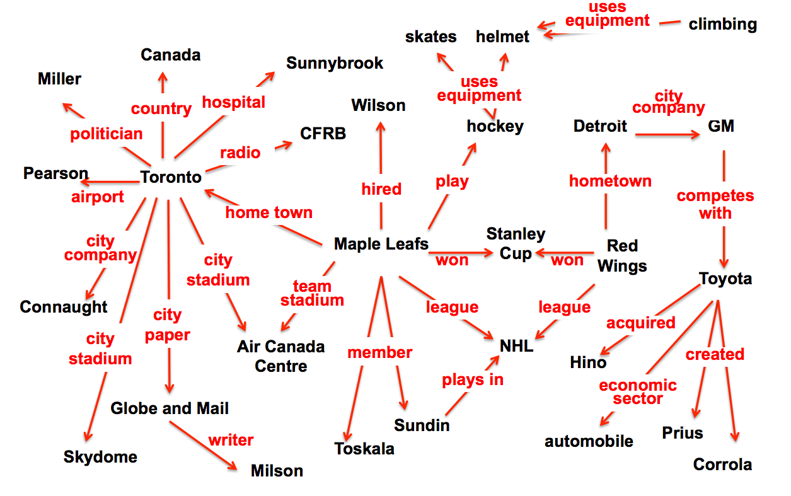
ProPPR: Infrastructure for Using Learned KBs [CIKM 2013,EMNLP 2014, MLJ 2015, IJCAI 2015, ACL 2015, IJCAI 2016]
Query answering: indirect queries requiring chains of reasoning
KB Completion: exploits redundancy in the KB + chains to infer missing facts

Slide 3
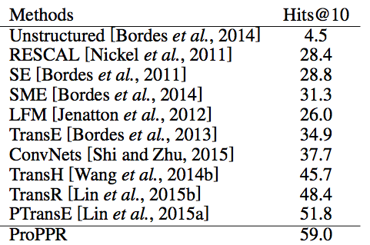
ProPPR: Infrastructure for Using Learned KBs [CIKM 2013,EMNLP 2014, MLJ 2015, IJCAI 2015, ACL 2015, IJCAI 2016]
Query answering: indirect queries requiring chains of reasoning
KB Completion: exploits redundancy in the KB + chains to infer missing facts
Freebase 15k benchmark
baseline method
tensor factorization
deep NN
embedding

Slide 4
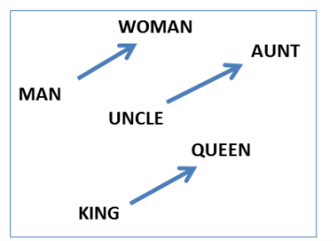
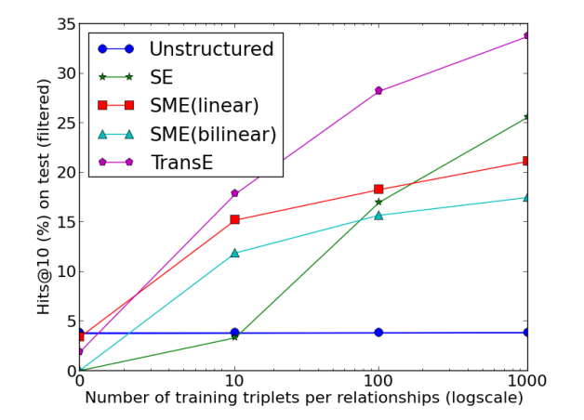
ProPPR: Infrastructure for Using Learned KBs [CIKM 2013,EMNLP 2014, MLJ 2015, IJCAI 2015, ACL 2015, IJCAI 2016]
TransE: find an embedding for entitities and relations so that R(X,Y) iff v_{Y}-v_{X} ~= v_{R}
v_{Y}
v_{X}
v_{R}
learned probabilistic
Alternative is explicit inference rules:
uncle(X,Y) :- aunt(X,Z), husband(Z,Y).
^

Slide 5
Relational Learning Systems
MLNs
ProPPR
Task |  | Task |  | Task
2. First order program |  | Clausal 1st-order logic |  | Function-free Prolog (Datalog)
3. “Compiled” representation |  | Undirected graphical model |  | Graph with feature-vector labeled edges
Inference | Learning | approx | approx | PPR (RWR) | pSGD
formalization
easy
harder?
+DB
“compilation”
sublinear in DB size
expensive
fast
can parallelize
linear
fast, but
not convex

Slide 6
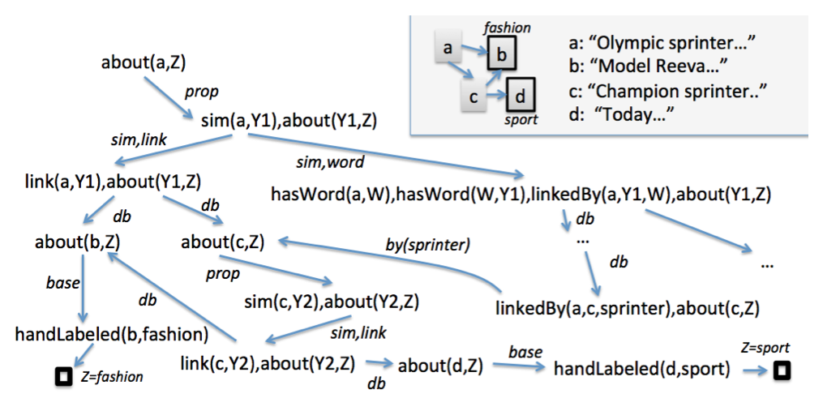
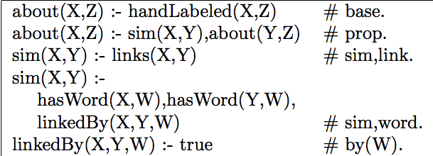
Query: about (a,Z)
DB
Program + DB + Query define a proof graph, where nodes are conjunctions of goals and edges are labeled with sets of features.
Program (label propagation)
LHS ➔ features

Slide 7
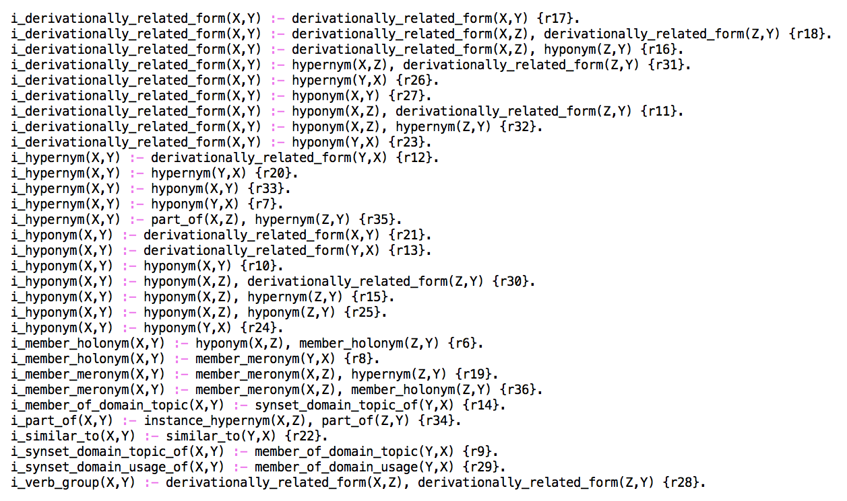
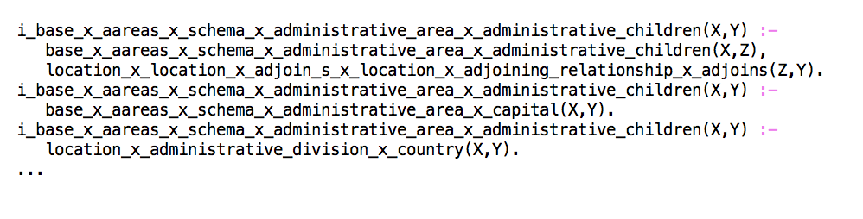
ProPPR: Infrastructure for Using Learned KBs [CIKM 2013,EMNLP 2014, MLJ 2015, IJCAI 2015, ACL 2015, IJCAI 2016]
total ~= 1350 rules from FreeBase 15k KB
ProPPR learns noisy inference rules to help complete a KB and then tunes a weight for each rule….
total 400+ rules from Wordnet KB

Slide 8

ProPPR: Infrastructure for Using Learned KBs [CIKM 2013,EMNLP 2014, MLJ 2015, IJCAI 2015, ACL 2015, IJCAI 2016]
Query answering: indirect queries requiring chains of reasoning
KB Completion: exploits redundancy in the KB + chains to infer missing facts
Freebase 15k benchmark
baseline method
tensor factorization
deep NN
with William Wang
CMU→UCSB

Slide 9
ProPPR: Infrastructure for Using Learned KBs [CIKM 2013,EMNLP 2014, MLJ 2015, IJCAI 2015, ACL 2015, IJCAI 2016]
Query answering: indirect queries requiring chains of reasoning
KB Completion: exploits redundancy in the KB + chains to infer missing facts
Past work: this works for KBC in NELL, Wikipedia infobox, …
From IJCAI:
Strong performance on FreeBase 15k – which is a very dense KB
Strong performance on WordNet (a second widely used benchmark)
Better learning algorithms (similar to the universal scheme MF method) get as much as 10% improvement in hits@10
From ACL 2015:
Joint systems that combine learning-to-reason with information extraction also improves performance….
William Wang
CMU→UCSB

Slide 10
ProPPR: Infrastructure for Using Learned KBs
But….
ProPPR is not deep learning!
Analysis:

Slide 11
ProPPR: Infrastructure for Using Learned KBs
ProPPR is not deep learning
Analysis:

Slide 12
ProPPR: Infrastructure for Using Learned KBs
ProPPR is not deep learning
Analysis:
Deep Learning
ProPPR

Slide 13
ProPPR: Infrastructure for Using Learned KBs
But:
ProPPR is not useful as a component in end-to-end neural (or hybrid) models
ProPPR can’t incorporate and tune pre-trained models for text, vision, ….
Solution:
A fully differentiable logic programming/deductive DB system (TensorLog)
Allow tight integration with models for sensing/abstracting/labeling/… and logical reasoning
Status: prototype

Slide 14
TensorLog: A Differentiable Probabilistic Deductive DB
What’s a probabilistic deductive database?
How is TensorLog different semantically?
How is it implemented?
How well does it work?
What’s next?

Slide 15
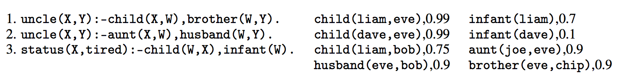

A PrDDB
Actually all constants are only in the database

Slide 16
A PrDDB
Old trick: If you want to weight a rule you can introduce a rule-specific fact….
r3. status(X,tired) :- child(W,X), infant(W), weighted(r3).
r3. status(X,tired) :- child(W,X), infant(W) {r3}.
weighted(r3),0.88
So learning rule weights (like ProPPR) is a special case of learning weights for selected DB facts.

Slide 17
TensorLog: Semantics 1/3
The set of proofs of a clause is encoded as a factor graph
Logical variable ➔ random variable; literal➔factor
status(X,tired):- parent(X,W),infant(W)
status(X,T):-
const_tired(T),child(X,W),
infant(W),any(T,W).
uncle(X,Y):-child(X,W),brother(W,Y)
X
W
brother
Y
child
X
const_tired
any
T
X
W
Y
child
aunt
husband
W
infant
uncle(X,Y):-aunt(X,W),husband(W,Y)
Key thing we can do now: weighted proof-counting

Slide 18
TensorLog: Semantics 1/3
Query: uncle(liam, Y) ?
General case for p(c,Y):
initialize the evidence variable X to a one-hot vector for c
wait for BP to converge
read off the message y that would be sent from the output variable Y.
un-normalized prob
y[d] is the weighted number of proofs supporting p(c,d) using this clause
uncle(X,Y):-child(X,W),brother(W,Y)
X
W
brother
Y
child
…
[liam=1]
[eve=0.99,bob=0.75]
[chip=0.99*0.9]
output msg for brother is sparse mat multiply: v_{W} M_{brother}
Key thing we can do now: weighted proof-counting

Slide 19
TensorLog: Semantics 1/3
But currently Tensor log only handles polytrees
For chain joins BP performs a random walk (without damping)
But we can handle more complex clauses as well
status(X,T):-
const_tired(T),child(X,W),
infant(W),any(T,W).
uncle(X,Y):-child(X,W),brother(W,Y)
X
W
brother
Y
child
X
const_tired
any
T
X
W
Y
child
aunt
husband
W
infant
uncle(X,Y):-aunt(X,W),husband(W,Y)
Key thing we can do now: weighted proof-counting

Slide 20
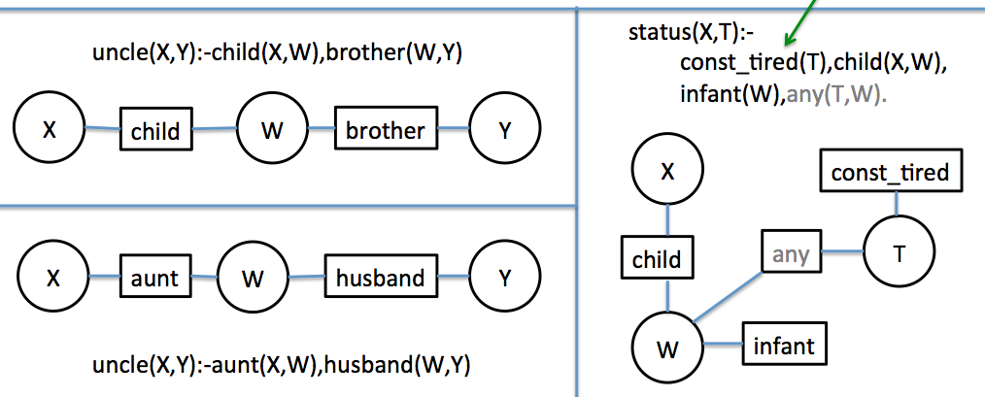
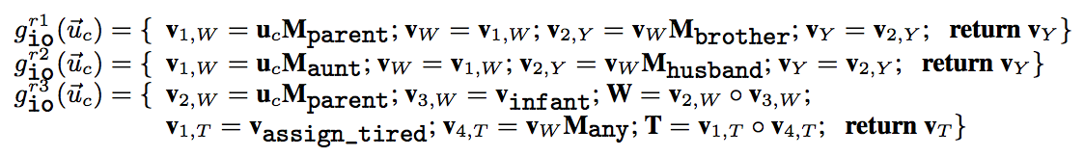
TensorLog: Semantics 2/3
Given a query type (inputs, and outputs) replace BP on factor graph with a function to compute the series of messages that will be passed, given an input…
can run backprop on these

Slide 21
TensorLog: Semantics 3/3
We can combine these functions compositionally:
multiple clauses defining the same predicate: add the outputs!
r1
g_{io}^{r1}(u) = { … return v_{Y;} }
g_{io}^{r2}(u) = { … return v_{Y;} }
r2
g_{io}^{uncle}(u) = g_{io}^{r1}(u) + g_{io}^{r2}(u)

Slide 22
TensorLog: Learning
This gives us a numeric function: y = g_{io}^{uncle}(u_{a})
y encodes {b:uncle(a,b)} is true and y[b]=conf in uncle(a,b)
Define loss(g_{io}^{uncle}(u_{a}), y*) = crossEntropy(softmax(g(x)),y*)
To adjust weights of a DB relation: dloss/dM_{brother}

Slide 23
TensorLog: Semantics vs Prior Work
TensorLog:
One random variable for each logical variable used in a proof.
Random variables are multinomials over the domain of constants.
Each literal in a proof [e.g., aunt(X,W)] is a factor.
Factor graph is linear in size of theory + depth of recursion
Message size = O(#constants)
Markov Logic Networks
One random variable for each possible ground atomic literal [e.g. aunt(sue,bob)]
Random variables are binary (literal is true or false)
Each ground instance of a clause is a factor.
Factor graph is linear in the number of possible ground literals = O(#constants ^{arity} )
Messages are binary

Slide 24
TensorLog: Semantics vs Prior Work
TensorLog:
Use BP to count proofs
Language is constrained to messages are “small” and BP converges quickly.
Score for a fact is a potential (to be learned from data), and overlapping facts in explanations are ignored.
ProbLog2, ….
Use logical theorem proving to find all “explanations” (minimal sets of supporting facts)
This set can be exponentially large
Tuple-independence: each DB fact is independent probability ➔ scoring a set of overlapping explanations is NP-hard.

Slide 25
TensorLog: implementation
Python+scipy prototype
Not integrated yet with Theano, …
Limitations:
in-memory database
binary/unary predicates, clauses are polytrees
fixed maximum depth of recursion
learns one predicate at a time
simplistic gradient-based learning methods
single-threaded

Slide 26
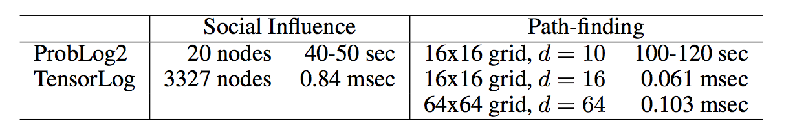
Experiments
Inference speed vs ProbLog2
ProbLog2 uses the tuple-independence model
x
 |  |  | y
Each edge is a DB fact
Many proofs of pathBetween(x,y)
Proofs reuse the same DB tuples
Keeping track of all the proofs and tuple-reuse is expensive….

Slide 27
Experiments
Inference speed vs ProbLog2
ProbLog2 uses the tuple-independence model
Tensor uses the factor graph model
x
 |  |  | y
TensorLog
BP is dynamic programming: we can summarize all proofs pathFrom(x,Y) by a vector of potential Y’s.

Slide 28
Experiments
Inference speed vs ProbLog2

Slide 29
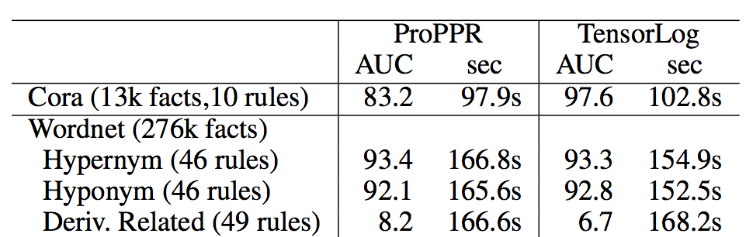
Experiments: TensorLog vs ProPPR
TensorLog vs ProPPR (one thread – same machine)
There’s a trip to convert fact-weights to rule-weights
ProPPR uses PageRank-Nibble approximation and is V3.x
TensorLog only learns one relation at a time….
!!
!

Slide 30
Outline going forward
What’s next?
Finish the implementation
Map over old ProPPR tasks (collaborative filtering, SSL, relation extraction, ….)
Structure learning
Not powerful enough for ProPPR’s approach, which is a second-order interpreter that lifts theory clauses to parameters.
Tighter integration with neural methods:
reasoning on top, neural/perceptual underneath
e.g., reasoning based on a embedded KB, a deep classifier,…

